Slide 1
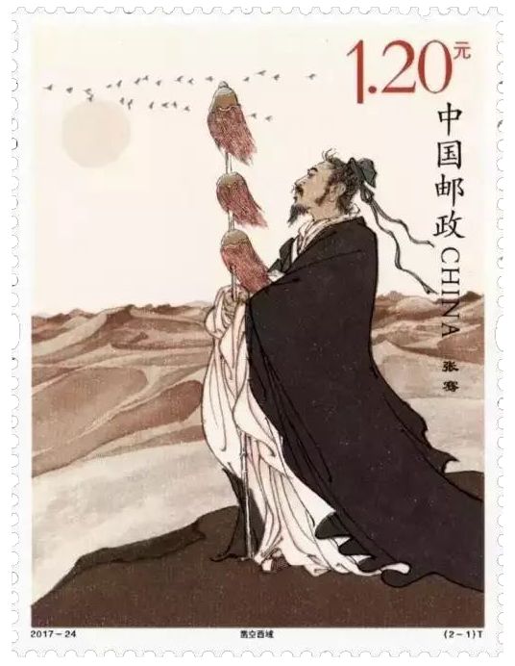
主題：兩漢通西域、軍事行動與中外文化交流
總論
本課題有兩個學習重點：一、從張騫通西域的歷史，了解絲綢之路的形成，以及中外文化的交流；二、從兩漢軍事擴張，認識漢帝國大一統政權的形成過程。
本章課題結構：
1. 漢朝與匈奴的接觸
2. 張騫通西域與絲綢之路的形成
3. 兩漢的軍事擴張，以及漢帝國版圖的擴大
4. 秦至漢的嶺南歷史，以及嶺南歸入漢帝國版圖的歷程
5. 漢代香港的歷史--李鄭屋邨漢墓（東漢時代）
教學節數建議：6
2017年中國郵政發行《張騫》特種郵票。圖中顯示張騫，手持代表外交使節的「旌節」，而背景是荒涼的沙漠，顯示了張騫不屈不撓的毅力。

Slide 2
Topic: Han China and the West Regions: Military Operations and Cultural Exchange
Introduction
This topic has two main learning points. Firstly, from the history of Zhang Qian, understand the journey through the Western Regions, the origins of the Silk Road, and Sino-foreign cultural exchange. Secondly, from the military expansion of Western and Eastern Han, understand the political process of the unification of the Han empire.
The structure of this topic:
1. Han dynasty and battles against the Huns (Xiongnu)
2. The journey of Zhang Qian through the Western Regions and Silk Road
3. Military campaigns and territorial expansion of the Han empire
4. The history of Southern China from Qin to Han.
5. The history of Hong Kong in the Han era – the Lei Cheng Uk Han Tomb Museum (Eastern Han era)
Number of Lessons: 6
In 2017, the China Post issued “Zhang Qian” as a special issue postal stamp. This image shows Zhang Qian holding the banner of a foreign envoy. The background is that of a desolate desert, representing the unyielding willpower of Zhang Qian.

Slide 3
學習重點：
漢朝與匈奴的接觸。
張騫通西域與絲綢之路的形成。
兩漢的軍事擴張，以及漢帝國版圖的擴大。
秦至漢的嶺南歷史，以及嶺南歸入漢帝國版圖的歷程。
漢代香港的歷史--李鄭屋邨漢墓（東漢時代）。

Slide 4
Learning Objectives
Han dynasty and battles against the Huns (Xiongnu)
The journey of Zhang Qian through the Western Regions and Silk Road
Military campaigns and territorial expansion of the Han empire
The history of Southern China from Qin to Han.
The history of Hong Kong in the Han era – the Lei Cheng Uk Han Tomb Museum (Eastern Han era)

Slide 5
關鍵詞 Key Terms
 | 英文詞彙 | 中文詞彙/粵語拼音 | 中文詞彙/普通話拼音
1 | Han Dynasty | 漢朝(hon3 ciu4) | 漢朝(hàn cháo)
2 | Hun (Xiongnu) | 匈奴(hung1 nou4) | 匈奴(xiōng nú)
3 | Chanyu | 單于(sin4 jyu4) | 單于(chán yú)
4 | Heqin (marriage alliance) Policy | 和親政策(wo4 can1zing3 caak3) | 和親政策(Héqīn zhèng cè)
5 | Emperor Wudi | 漢武帝(hon3 mou5 dai3) | 漢武帝(hàn Wǔdì)
6 | Zhang Qian | 張騫(zoeng1 hin1) | 張騫(Zhāng Qiān)
7 | Western Regions | 西域(sai1 wik6) | 西域(xī yù)
8 | Da Rouzhi state | 大月氏(daai6 juk6 zi1) | 大月氏(Dà Ròuzhī)
9 | Silk Road | 絲綢之路(si1 cau4 zi1 lou6) | 絲綢之路(sī chóu zhī lù)
10 | The Hexi Corridor | 河西走廊(ho4 sai1 zau2 long4) | 河西走廊(Héxī zǒu láng)
11 | Huo Qubing | 霍去病(fok3 heoi3 bing6) | 霍去病(Huò Qùbìng)
12 | Southern Yue state | 南越國(naam4 jyut6 gwok3) | 南越國(nán yuè guó)
13 | Lei Cheng Uk Han Tomb | 李鄭屋漢墓(lei5 zeng6 uk1 hon3 mou6) | 李鄭屋漢墓(lǐ zhèng wū hàn mù)

Slide 6
概要
從張騫通西域的歷史，了解絲綢之路的形成，以及中外文化的交流。
從兩漢軍事擴張，認識漢帝國大一統政權的形成過程。

Slide 7
Key Points
From the history of Zhang Qian, understand the journey through the Western Regions, the origins of the Silk Road, and Sino-foreign cultural exchange.
From the military expansion of Western and Eastern Han, understand the political process of the unification of the Han empire.

Slide 8
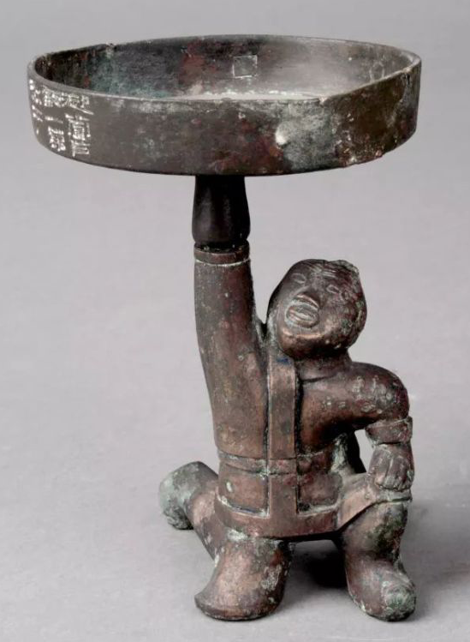
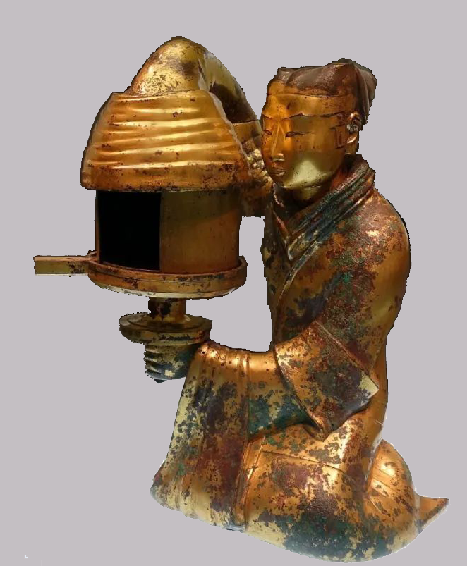
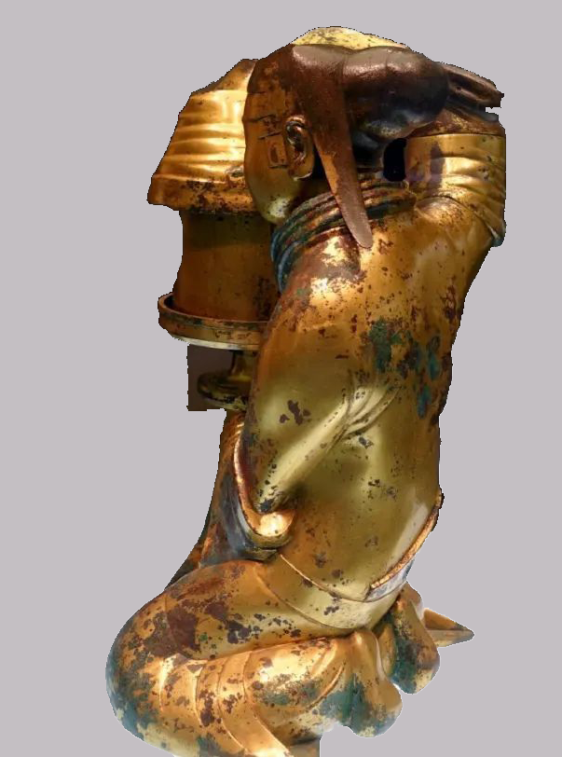
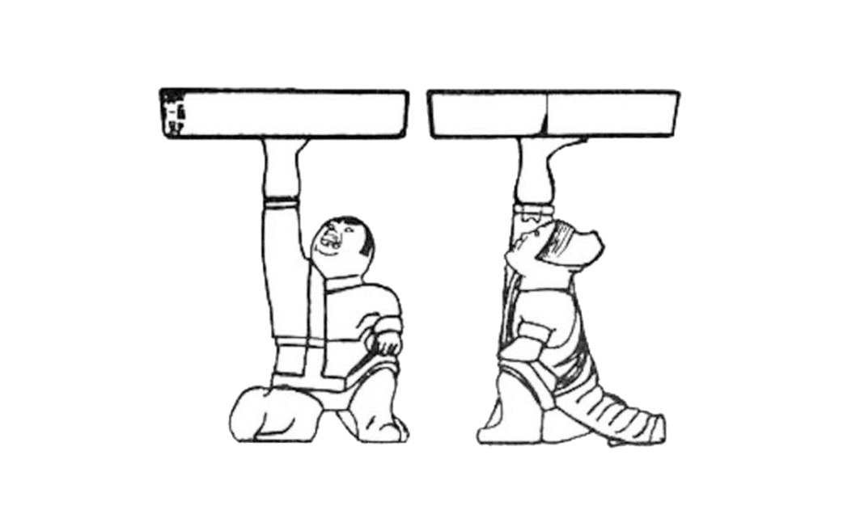
一、認識匈奴
1.匈奴人和漢人的分別
1968年，考古學家在河北省發現西漢中山靖王劉勝（公元前113年死）及其夫人竇氏的墓，其中的陪葬品有兩件銅製油燈，均是以銅俑托燈，但一個銅俑是漢人，一個是匈奴人，請分辨。
這是：漢人/匈奴人
想一想：漢人與匈奴人在服飾上有什麼差別？
（答案：匈奴人服裝比較輕便，方便騎馬。）
這是：漢人/匈奴人
當戶銅燈（河北博物院藏）
長信宮燈（河北博物院藏）

Slide 9
1. Understanding the Huns
A. The difference between Hun and Han people
In 1968, archaeologists at Hebei province discovered the two graves of the Prince of Zhongshan during the Western Han, Liu Sheng (died in 113 B.C.), and his wife Lady Dou. Two copper oil lanterns were among the funerary items. Both were copper figurines holding lanterns. However, one copper figurine was a Han person while the other was a Hun. Please differentiate the two.
This is: Han/ Hun
Think: What is the difference between Han and Hun clothing?
(Answer: The clothing of the Hun people was lighter and more convenient for horseriding.)
This is: Han/Hun
Copper lantern (Hebei Museum Collection)
Copper lantern (Hebei Museum Collection）

Slide 10
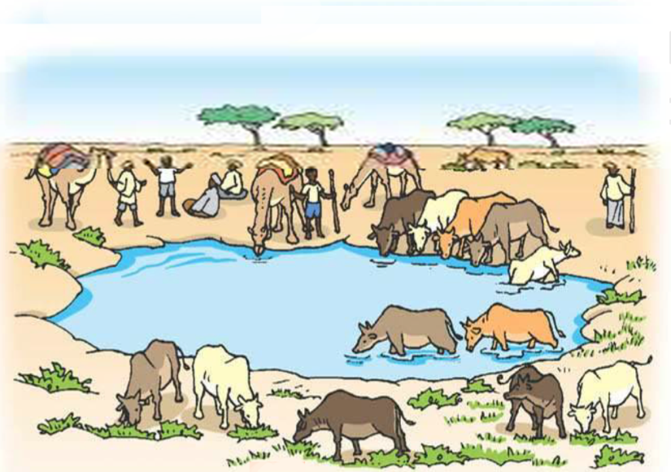
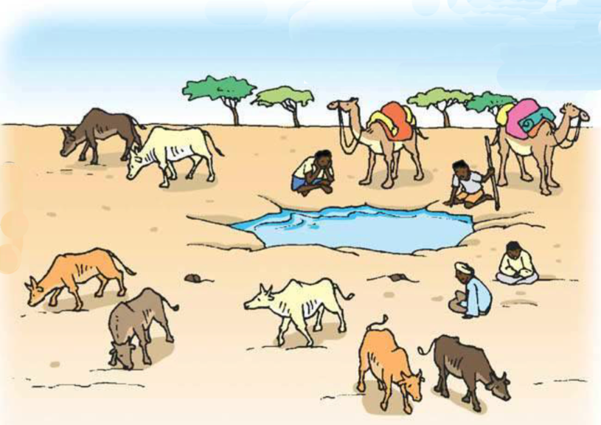
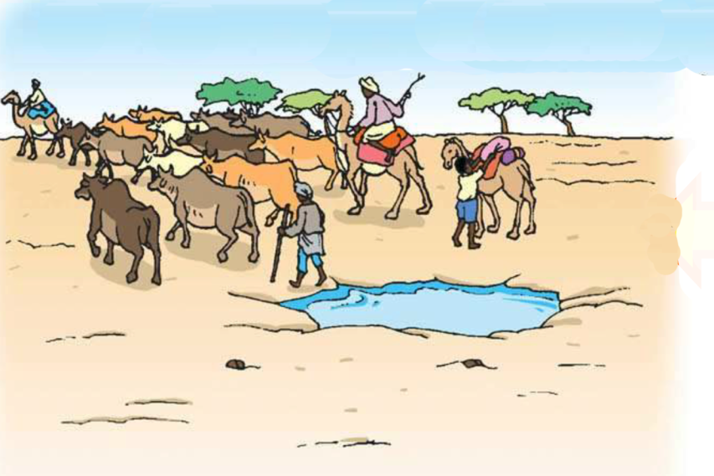
2.「逐水草而居」的匈奴人
1
所謂「逐水草而居」，即「遊牧」，重點是牧民把牛羊帶到有水有草的地方飼養：
找到一個水源，附近有草，牛羊這這裏生活，長得很快。
受季節或天氣的影響，水源乾涸了，草也減少。
帶著牛羊離開，找尋另一個有水有草的地方。
3
2
活動：試根據以上的描述，在右面的三幅圖填上1-3的數字。
互聯網圖片

Slide 11
B. The Huns who “lived wherever there was grass and water”
1
The Huns were said to have “lived wherever there was grass and water”. In other words, they were “nomadic”. This meant that they were herdsmen who brought their livestock to places with grass and water.
The herdsmen found a water source. Nearby, there would be grass. Cows and goats could survive here and grow very quickly.
When the seasons or weather changed, the water source could dry up. Grass would also be reduced.
The herdsmen would take their livestock away and search for another place with water and grass.
3
2
Activity: According to the above description, label the three images on the right from 1 to 3.
Image from Internet

Slide 12
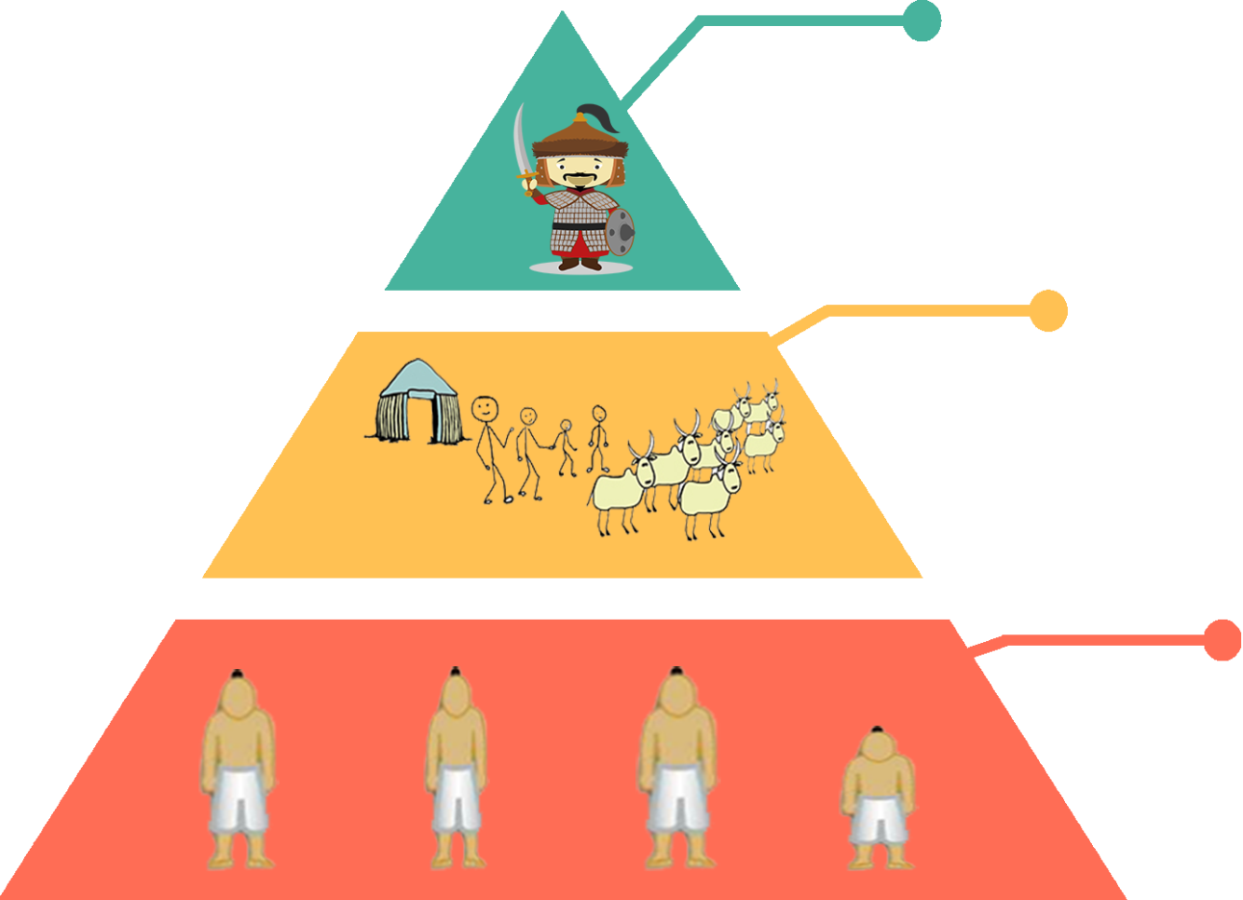
3.匈奴的社會組織
匈奴生活於中國北部，該處佈滿了大大小小的遊牧部落，部落中可以分為三個等級：
部落社會
部落領袖：如遇上乾旱天氣，牛羊死亡，食物不繼，便會帶領族人攻打其他部落進行搶掠。
牧民：放牧為生，貧富差別，在於擁有多少牛羊和奴隸。
奴隸：多是從戰爭中俘虜回來，從事最低下的工作。

Slide 13
C. Hun Social Structure
There were many nomadic Hun tribes of various sizes in Northern China. Their society could be divided into three levels.
Tribe Society
Nomadic leader: In a drought, when cows and sheep died and there was not enough food, they could lead tribe members to attack and loot other tribes.
Herdsman: Brought their livestock to graze. The difference between the poor and the rich depended on how many livestock and slaves they possessed.
Slave: These were mostly war captives and they handled the lowest work.

Slide 14
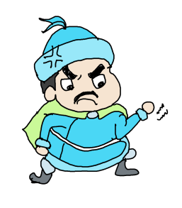
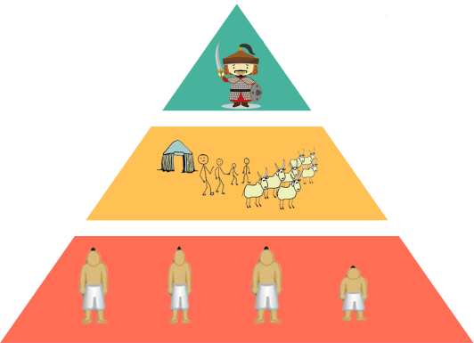
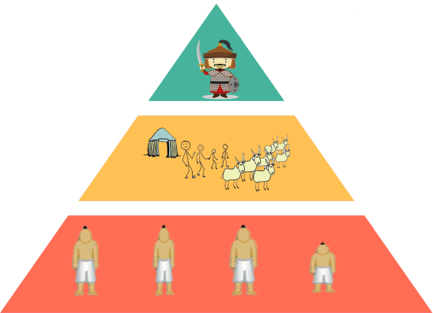
每個部落，只有數百至數千人，因此對漢朝毫無威脅可言。
不過若它們聯盟起來，便是可怕的軍事力量。這個情況，在漢朝初年發生。
匈奴部落的聯盟領袖，叫做「單于」，是由各個部落領袖推舉出來的。
「單于」的主要職責，就是帶領各部落進行戰爭；戰爭勝利，便負責分配戰利品（金銀、糧食、奴隸等）
帶領你們的牧民，跟我一起去打仗吧！
單于

Slide 15
Each tribe only had a few hundred to a few thousand people. Therefore, it could be said that the Han Dynasty totally lacked threats.
However, if they formed an alliance, they could be a powerful military power. This happened in the early years of the Han Dynasty.
The leader of the Hun tribal alliance leader was called the “Chanyu”. He was elected by the leaders of every tribe.
The main responsibility of the “Chanyu” was to lead every tribe into war. Once the war was won, the “Chanyu” would be responsible for dividing loot (such as silver and gold, food, and slaves).
Bring your herdsmen! I will lead you into battle!
Chanyu

Slide 16
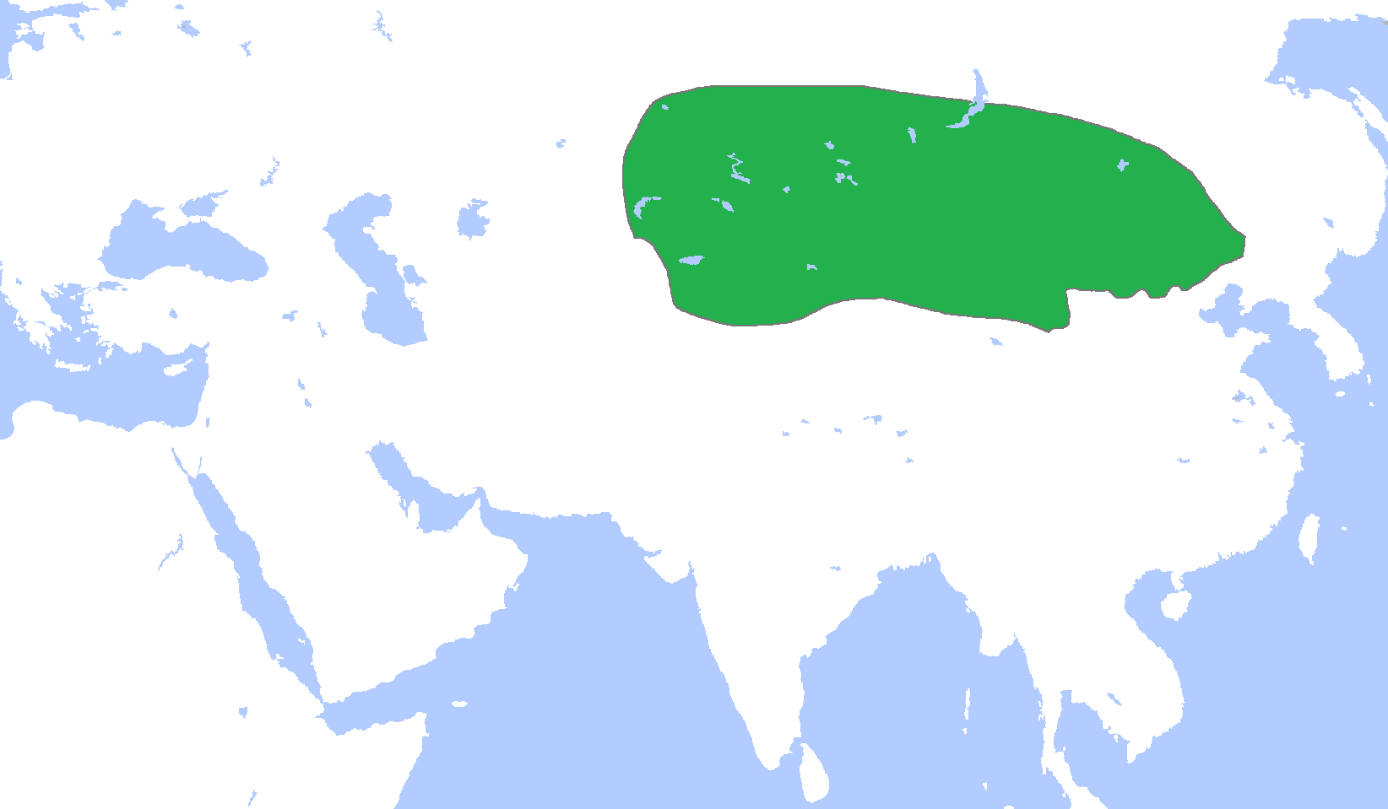
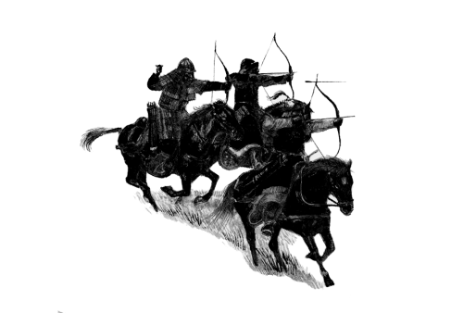
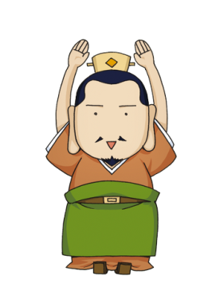
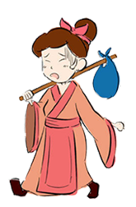
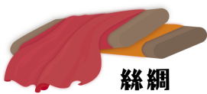
4.匈奴的威脅
匈奴支配地域
戰國時期，匈奴曾與中國北部的國家，如秦、趙、燕發生過戰爭。到了公元前200年，匈奴再度大規模入侵，漢高祖劉邦親率大軍與匈奴交戰，戰事失利，更一度被圍困於白登山（今山西省大同）7日，最後逃回長安。自此之後，漢朝採取「和親政策」，籠絡匈奴，以換取太平。
冒頓單于
白登
和親政策
劉邦
很屈辱，沒面子！
和平
西漢
想一想：戰國時期這些國家怎樣防範匈奴的入侵？
A 研製火藥
B 建造長城
C 散播瘟疫
公主
答案：B

Slide 17
D. The Menace of the Huns
In the Warring States period, wars often broke out between the Huns and northern Chinese states. In 200B.C., the Huns invaded the Han empire. Liu Bang, the founding emperor, led a large army and battled the Huns but was defeated. He was surrounded and trapped at the Baideng hill (in modern day Datong, Shanxi province) for 7 days. In the end, he escaped back to the capital of Chang’an. Since then, the Han Dynasty used the policy of heqin (marriage ties for peace) to make peace with the Huns, exchanging marriages for peace and security.
Hun Controlled Area
Maodun Chanyu
Baideng hill
Liu Bang
Heqin (marriage alliance) Policy
Very humiliating! No face!
Peace
Western Han
Think: During the Warring States period, how did northern states prevent invasion by Huns?
A made gunpowder
B constructed the Great Wall
C spread plague
silk
Princess
Answer：B

Slide 18
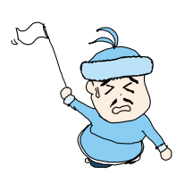
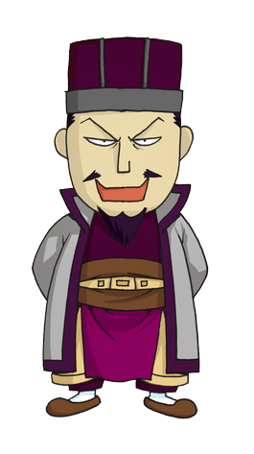
二、張騫出使西域
1.漢武帝的計劃
到了公元前141年，漢武帝登基，決定取消和親政策，並派軍隊消滅匈奴。
最好是聯合與匈奴有仇的大月氏國一齊攻打匈奴，哈哈！
大月氏
西漢
漢武帝

Slide 19
2. Diplomatic Mission of Zhang Qian to the Western Regions
A. The Plan of Emperor Wudi
In 141 B.C., Emperor Wudi ascended to the throne. He abolished the heqin policy and planned to send armies to eliminate the Huns.
It would be best to ally with the Da
Rouzhi state, who hates the Huns, and attack the Huns together! Haha!
Emperor Wudi
Da Rouzhi
Western Han

Slide 20
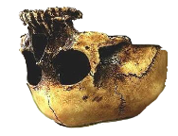
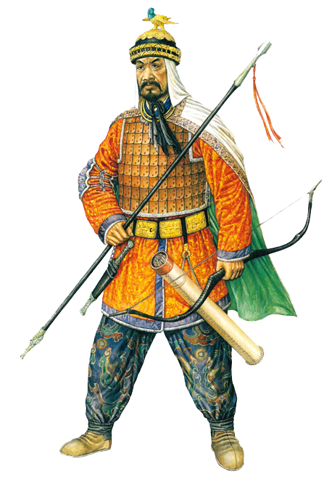
匈奴的威脅
老上單于（冒頓單于兒子）
這頭可以用來作酒杯！
匈奴支配地域
162BC
月氏
大月氏
月氏也是遊牧民族，但不斷被匈奴攻打，公元前162年，在一場戰爭中，月氏大敗，月氏王的頭也被老上單于割下作盛酒的容器。月氏族人為了躲避匈奴，西遷並建立大月氏國。
西漢
匈奴人的形象（《長城歷史與文物》，香港歷史博物館，頁200）

Slide 21
The Menace of the Huns
Laoshang Chanyu (son of Maodun Chanyu)
This head can be used as a wine container!
Huns controlled area
162BC
Rouzhi
Da Rouzhi
Rouzhi was also a nomadic ethnicity, but they were attacked nonstop by the Huns. In 162 B.C., Rouzhi was again defeated. The head of its king was cut and used a as wine container by Laoshang Chanyu. To escape from the attacks, the tribe migrated westwards and established the Da Rouzhi state.
Western Han
A Hun soldier (ref: History and Relics of the Great Wall, p. 200)

Slide 22
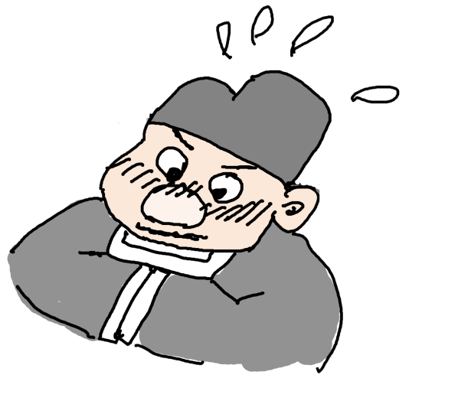
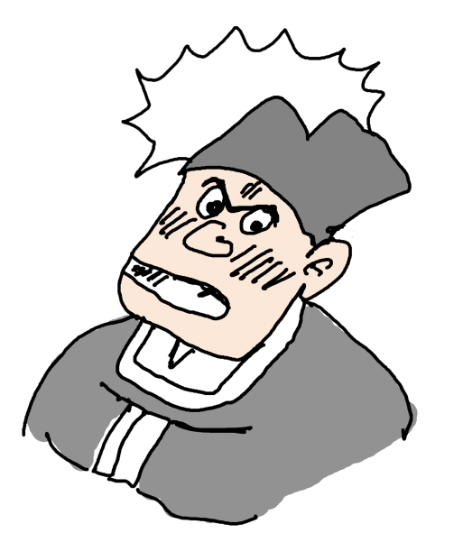
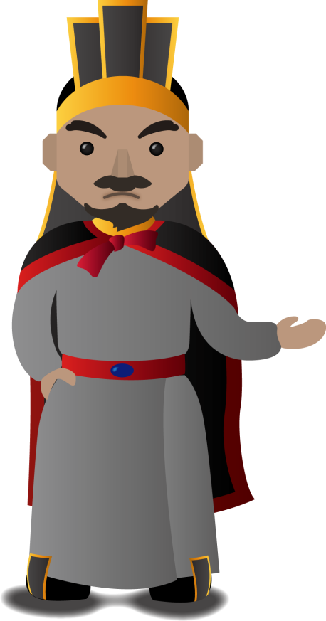
路途遙遠，我可不想去送死啊！
我上有老母，下有妻兒要照顧，根本就走不開啊！
本王要派一個使者前往大月氏，有誰願意去啊！
我叫張騫，今年25歲，是本朝一名小官，願意為朝廷效力！

Slide 23
So far away! I don’t want to go and die!
I need to take care of my mother, my wife, and my child! I cannot leave!
I, the emperor, need to send an envoy to Da Rouzhi. Who will agree to go?
My name is Zhang Qian. I am 25 this year and I am just a junior official of this dynasty. I agree to serve the government.

Slide 24
想一想：張騫接受任命，出使大月氏，顯示他具有什麼性格？試從下列找出四項：
忠心
誠實
不怕艱難
願意適應其他文化
挑戰自己的能力
勤奮

Slide 25
Think: What kind of personality did Zhang Qian have? Find four characteristics he had from below.
Loyal
Honest
Not afraid of challenges
Willing to adapt to other cultures
Willing to improve
Hardworking

Slide 26
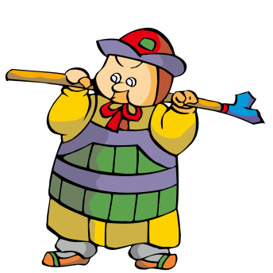
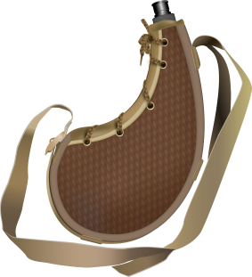
想一想：路途遙遠，請你為張騫挑選四種適合的隨行東西。
隨從
✔
那時根本沒有地圖，究竟要走多遠才到達大月氏，即使張騫自己也不知道。
✔
食物、水
地圖
✔
旌節
（使節的象徵）
✔
指南針
馬
當時還未發明指南針，張騫是利用觀星辨別方向的。

Slide 27
Think: Choose four appropriate items for Zhang Qian to bring on his journey
Attendants
There were no maps at that time. Zhang Qian needed to walk very far to reach Da Rouzhi. Even Zhang Qian himself did not know the way.
✔
✔
Rations, water
Map
✔
Staff (the symbol of an envoy)
✔
Compass
Horse
The compass had not been invented yet. Zhang Qian used directions from stars and constellations.

Slide 28
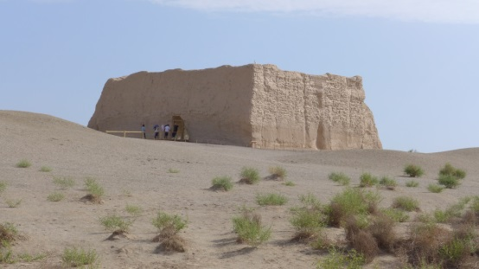
為了阻擋來自北方的匈奴入侵首都長安，漢武帝在長安的北方興築了長城，並在接近西面的盡頭，建立了一個軍事據點，叫做「玉門關」（據說販賣玉石的西域商人均從這裏進入漢帝國）。
2.何處是西域？
玉門關關城遺跡（2013年攝）
要出使大月氏,張騫首先需要經過出玉門關，然後再通過「西域」 。 「西域」的範圍，包括了今日新疆一帶的地方。當時那裏有很多個小國，均深受匈奴的壓迫。
天山
西域
沙漠
崑崙山
長安

Slide 29
To resist invasions from the Northern Huns of the capital Chang’an, Emperor Wudi constructed Great Wall to the north of Chang’an. At the western side, he made a military stronghold called the “Yumen Pass” or “Pass of the Jade Gate”. During the Han Dynasty, this was a gate through which jade merchants from the West Region entered China.
B. Where were the Western Regions?
Remains of a fort at Yumen Pass (Photo from 2013)
To arrive at Da Rouzhi, Zhang Qian would need to go through Yumen Pass and then through the Western Region. The Western Regions included modern-day Xinjiang. At the time, there were many small states there that were oppressed by the Huns.
Heavenly Mountain
Western Regions
Deserts
Kunlun Mountain
Chang’an

Slide 30
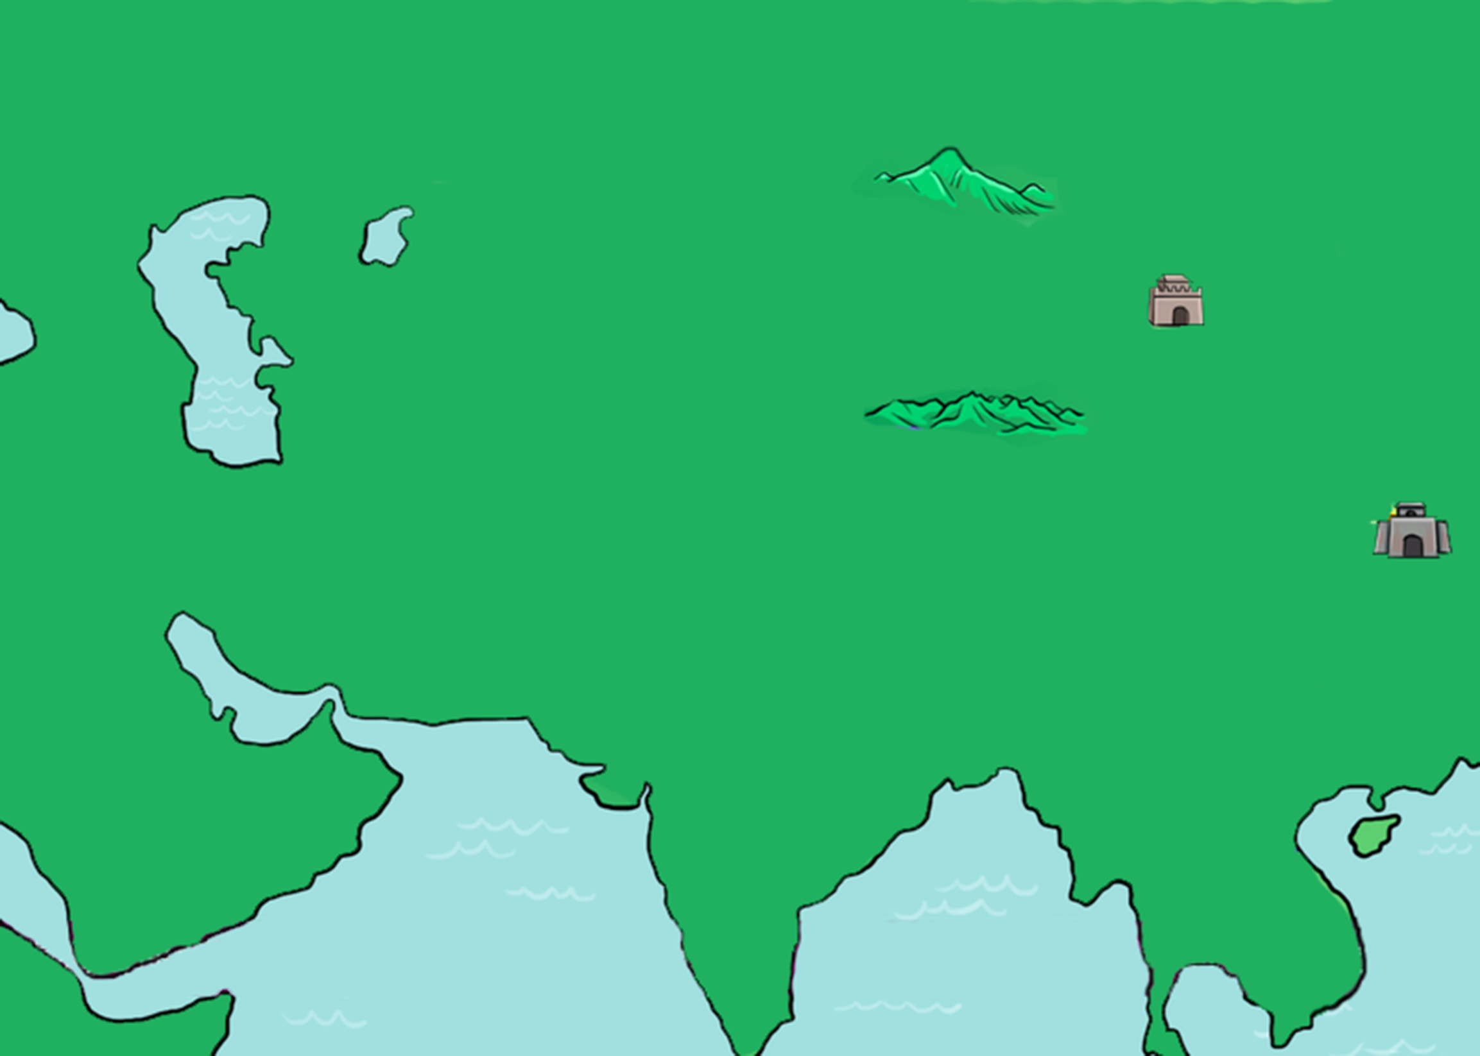
活動：從玉門關進入西域，只有兩條路線有機會去到大月氏。這兩條路線是：
天山
A
玉門關
A
和
C
大月氏
B
C
B
是難以行走的路線，因為要經過廣闊的沙漠。
崑崙山
長安

Slide 31
Activity: From the Yumen Pass, there were only practically two routes to Da Rouzhi. These two routes are:
Heavenly mountain
A
Yumen Pass
A
and
C
Da Rouzhi
B
C
B
was a difficult route because one needed to pass through a vast desert.
Kunlun mountain
Chang’an

Slide 32
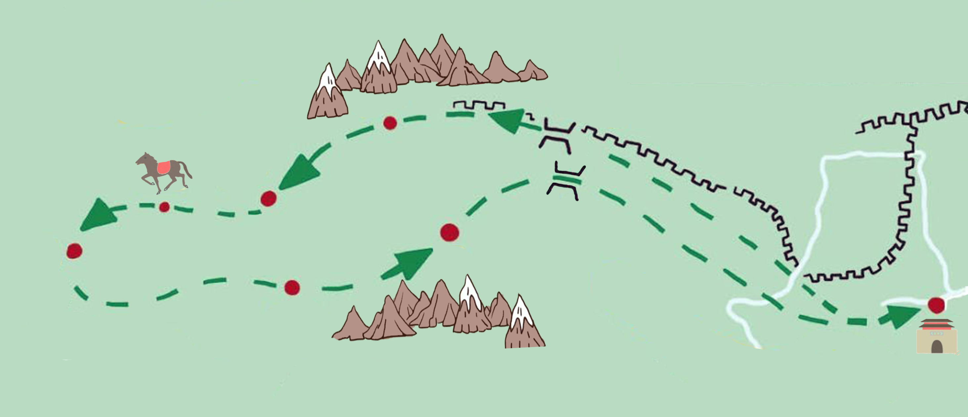
3.張騫通西域（首次）
天山
匈奴
玉門關
康居
烏孫
被匈奴抓住
逃出
B
疏勒
（龜茲）
又被匈奴抓住
陽關
C
鄯善
目的地
D
（大宛國）
（大月氏）
于闐
大夏
活動：試根據下面張騫的行程資料，將有關地名填寫在地圖（ＡＢＣＤ）上：
崑崙山
A
張騫行程：
1. 公元前138年，張騫帶著隨從百多人，離開長安，向西域進發。
2. 誰知他一踏出玉門關不遠，在龜茲附近，已被匈奴人抓住，囚禁十多年。匈奴人為了留住張騫，甚至為他娶了妻子。
3. 可是張騫出使西域的信心沒有動搖，他趁機成功逃走，繼續行程。
4. 張騫到達了大宛國，發現當地出產良馬。他想，如果漢朝有這些良馬，便不怕匈奴騎兵了。
5. 張騫終於到達目的地大月氏。國王很禮待張騫，但不想再與匈奴為敵，張騫只好離去。
6. 公元前126年，張騫終於經過陽關，回到長安。
（長安）

Slide 33
C. The First Mission of Zhang Qian to the Western Regions
Heavenly mountain
Huns
B
Yumen pass
Kangju
Wusun
Captured by Huns
Escaped
Qiuci
Shule
Captured by Huns again
Yangguan Pass
Destination
C
Shanshan
D
Dayuan
Da Rouzhi
Yutian
Daxia
Kunlun mountain
Activity: According to Zhang Qian’s itinerary listed below, fill in the relevant location names （A, B, C and D）on the map.
A
Chang’an
Zhang Qian’s itinerary
1. 138 B.C., Zhang Qian with an entourage of over a hundred people left Chang’an for the Western Regions.
2. He was captured by Huns not far from the Yumen pass, near Qiuci, and imprisoned for more than a decade. During his detainment, Zhang Qian married a women, grasped Hun language and mastered local terrain.
3. But Zhang Qian was not swayed from his mission to the Western Regions. He seized an opportunity to escape and continued his journey.
4. Zhang Qian arrived at Dayuan and discovered the locality produced good horses. He thought, if the Han dynasty had horses like these, they would not fear Hun cavalry.
5. Zhang Qian finally arrived at the destination, Da Rouzhi. The king very politely received Zhang Qian, but did not want the Huns as enemies again. Zhang Qian left.
6. In 126 B.C., on his returned journey, Zhang Qian finally arrived back at Chang’an via the Yangguan Pass.

Slide 34
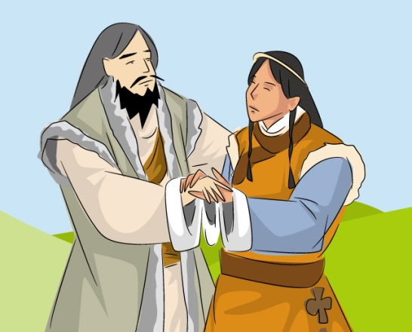
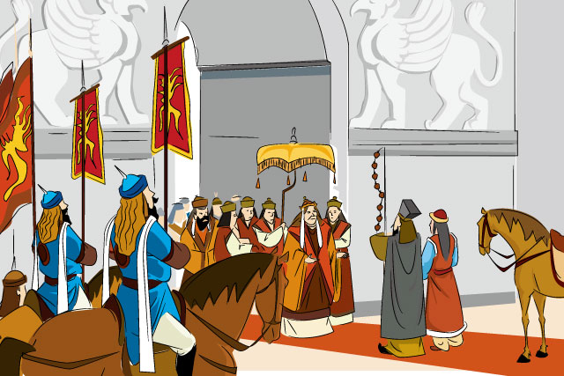
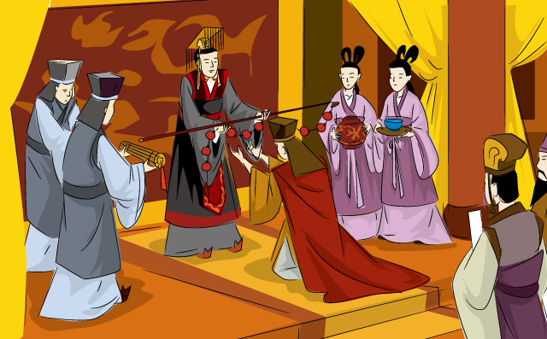
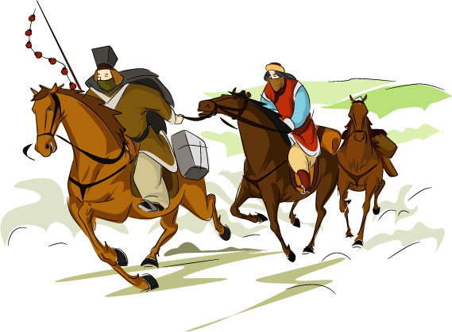
活動：連線
公元前138年，漢武帝在長安把旌節給了張騫，命他出使西域。
張騫踏出玉門關不遠，被匈奴人抓住，囚禁十多年。匈奴人為了留住張騫，為他娶妻成家。
張騫乘著匈奴人看守鬆懈，帶著妻子逃走了，繼續西域的行程。
張騫終於到達大月氏。國王對他很是禮遇，但已沒有興趣再與匈奴為敵。

Slide 35
Activity: Match the text with the picture
In 138 B.C., Zhang Qian with an entourage of over a hundred people left Chang’an for the Western Regions.
He was captured by Huns not far from the Yumen pass, near Qiuci, and imprisoned for more than a decade. During his detainment, Zhang Qian married a women, grasped Hun language and mastered local terrain.
But Zhang Qian was not swayed from his mission to the Western Regions. He seized an opportunity to escape and continued his journey
Zhang Qian finally arrived at the destination, Da Rouzhi. The king very politely received Zhang Qian, but did not want the Huns as enemies again. Zhang Qian left.

Slide 36
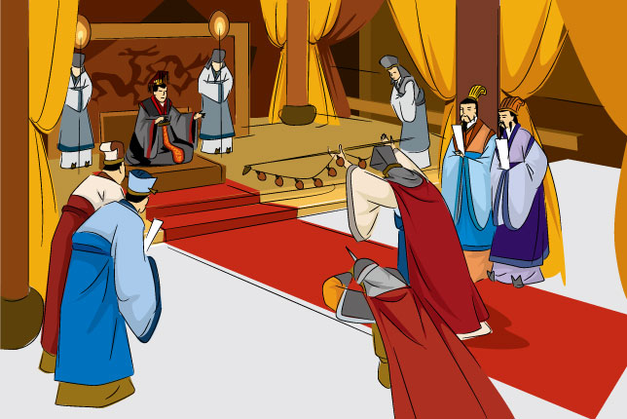
公元前126年，張騫回到長安，見到漢武帝。漢武帝知道西域的大概情況。
好極了！我升你官，做大夫；封做貴族，叫博望侯吧。
我後悔當初沒出使西域！
大王，西域現時的情況是這樣…這樣…

Slide 37
126 B.C., Zhang Qian returned to Chang’an and saw Emperor Wudi. From Zhang, the emperor now roughly knew of what had happened in the Western Regions.
Very good! I promote you to the status of marquis.
I regret not going to the Western Regions!
Your Majesty, the situation in the Western Regions is now like this…

Slide 38
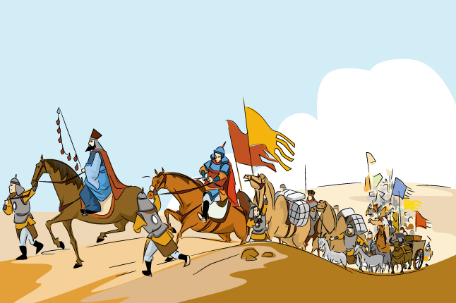
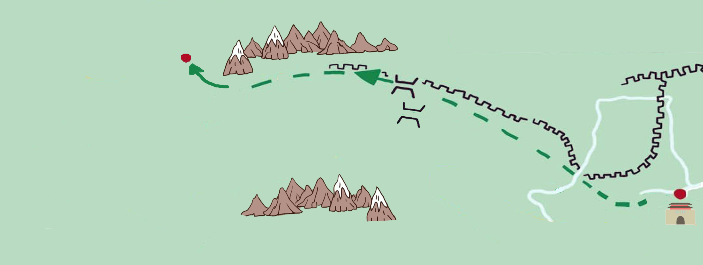
4.張騫通西域（第二次）
我組織了三百多人的使團、大量錢幣、絲綢等禮物，以及數萬頭牛羊，送給烏孫王，他必定答應我的請求。
公元前119年，漢武帝為了對付匈奴，命張騫第二次出使西域，目的地是烏孫。
張騫
想一想：觀察烏孫的位置。為什麼漢武帝要聯絡烏孫？
天山
烏孫
匈奴
漢

Slide 39
D. The Second Mission of Zhang Qian to the Western Regions
I gathered over three hundred people for this diplomatic mission. I brought money, silk cloth, tens of thousands of livestock, and other presents to give to the King of Wusun. Then, he must listen to my requests.
Zhang Qian
In 119 B.C., Emperor Wudi ordered Zhang Qian to go to the Western Regions a second time to handle the Huns. This time, the objective was Wusun.
Think: Examine the location of Wusun and consider why Emperor Wudi needed to contact Wusun.
Tianshan
Wusun
Hun
Han

Slide 40
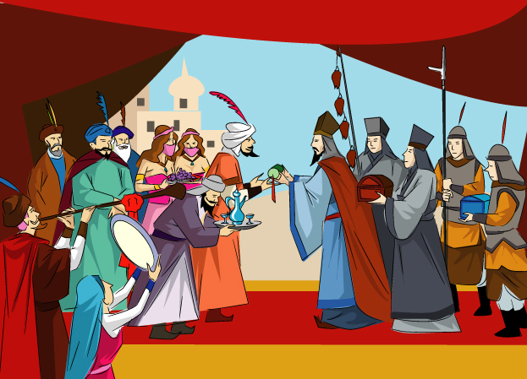
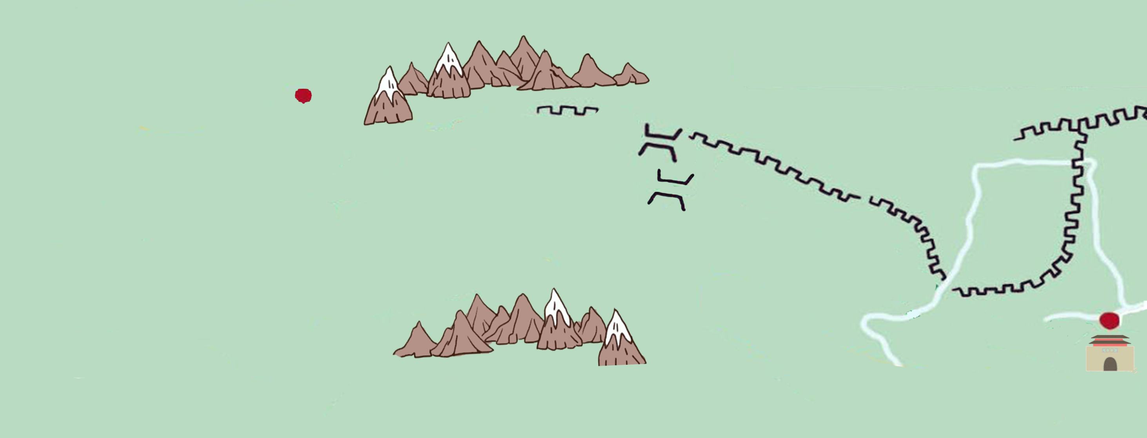
4.張騫通西域（第二次）
烏孫王：博望侯太客氣了。禮物我收下，不過沒有計劃出兵匈奴。
唉!又失敗了！
公元前119年，漢武帝為了對付匈奴，命張騫第二次出使西域，目的地是烏孫。
想一想：觀察烏孫的位置。為什麼漢武帝要聯絡烏孫？
答案:漢武帝希望聯絡烏孫人與漢朝左右夾擊匈奴。（不過計劃還是落空了）
匈奴
烏孫
漢

Slide 41
D. The Second Mission of Zhang Qian to the Western Regions
King of Wusun: You are so generous. I will receive the gifts but I do not plan to send soldiers to fight the Huns.
Oh no! Failed again!
In 119 B.C., Emperor Wudi ordered Zhang Qian to go to the Western Regions a second time to handle the Huns. This time, the objective was Wusun.
Think: Examine the location of Wusun and consider why Emperor Wu of Han needed to contact Wusun.
Answer: Emperor Wudi had hoped to contact Wusun people to arrange for a pincer attack on the Huns. However, this plan failed.
Huns
Wusun
Han

Slide 42
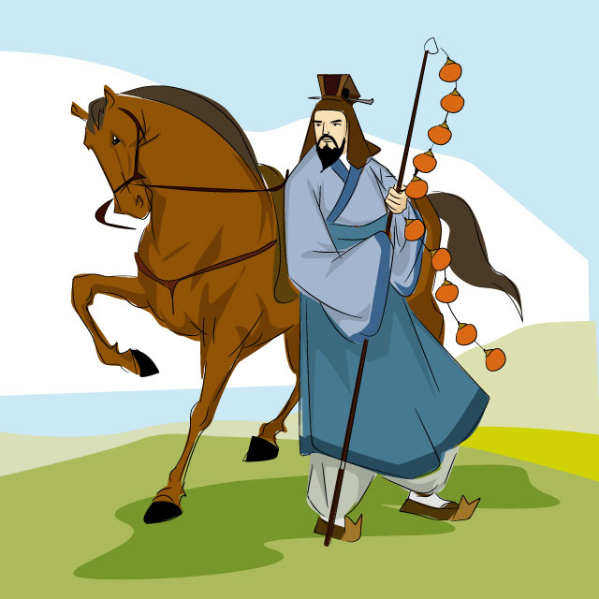
5.張騫的貢獻
將來的人如何評價我我一生的成就？
活動：請在空格上填上“X”（表示失敗）或“✔”（表示成功）
×
外交上 （聯合西域國家夾擊匈奴）
✔
文化交流
✔
絲綢之路（張騫往返西域的路線，後來成了「絲綢之路」）

Slide 43
E. Accomplishments of Zhang Qian
Activity: Please write“X”(to indicate failure) or “✔”(to indicate success) in the below boxes
How will people in the future evaluate me and my accomplishments?
Diplomacy (allied with the Western Regions to attack the Huns together)
×
✔
Cultural exchange
Silk Road (The route that Zhang Qian took to and from the Western Regions later became “the Silk Road”)
✔

Slide 44
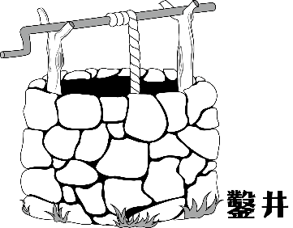
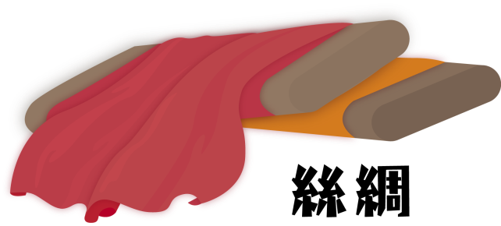
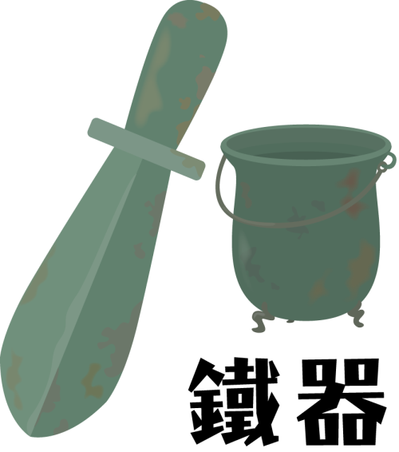
活動：張騫從中國帶了5項物品或技術到西域，你能找出來嗎？
✔
✔
✔
✔
✔

Slide 45
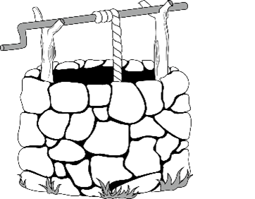
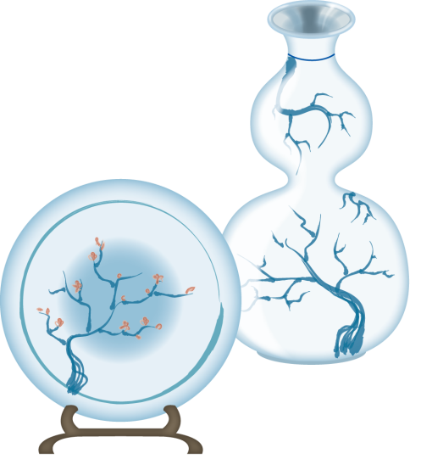
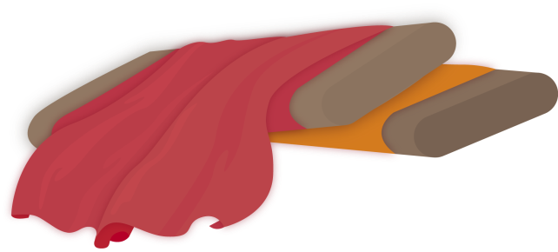
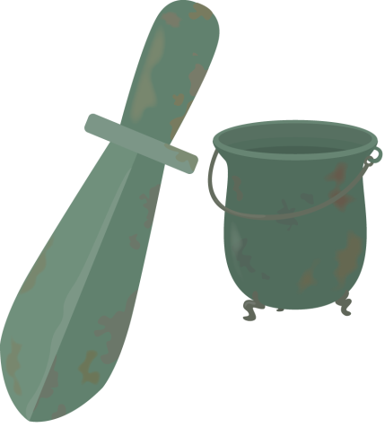
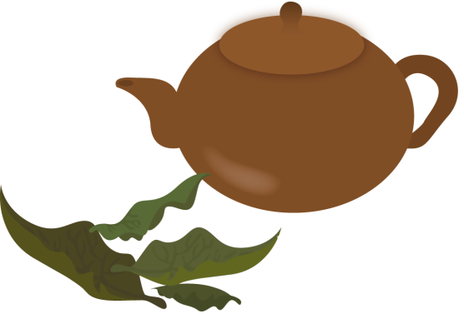
Activity: Zhang Qian brought 5 products or technologies from China to the Western Regions. Can you find them?
porcelain
grape
✔
✔
silk
✔
Technology of digging well
✔
✔
spices
foreign music
ironware
tea leaves

Slide 46
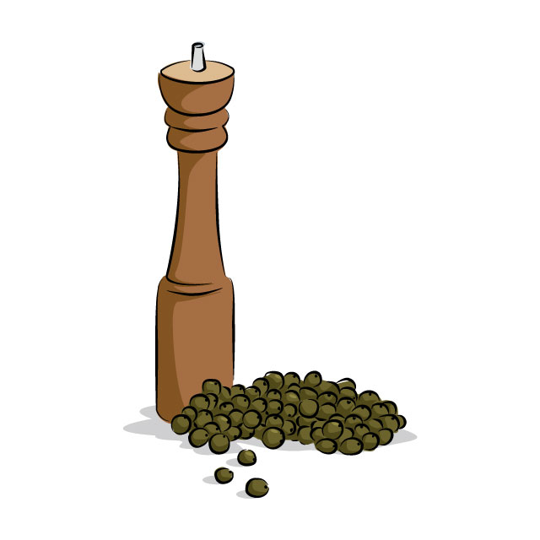
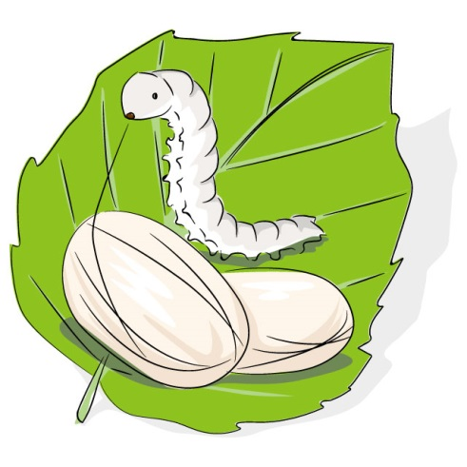
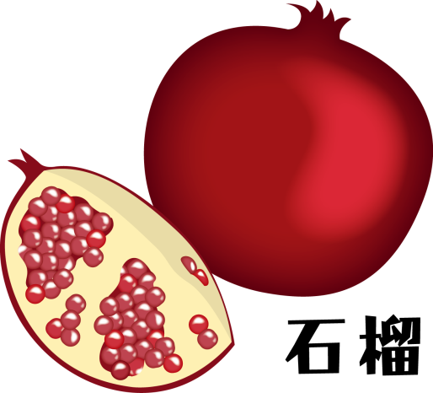
活動：張騫從西域帶回5項物品或技術到中國，你能找出來嗎？
✔
✔
✔
胡椒
薯條
✔
✔
養蠶技術
鐵器

Slide 47
Activity: Zhang Qian brought 5 products or technologies from the Western Regions back to China, can you find them?
✔
✔
✔
grape
pepper
French Fries
spices
✔
✔
ironware
raising silkworms
foreign music
grava fruit

Slide 48
活動：除列出的事物外，請你舉出你家鄉的特產、器物、宗教或技術的例子，是今天仍在中國 / 香港常見 / 流行。如菠菜、開心果、芝麻、玉石、珠寶、佛教、伊斯蘭教、毛織品技術、雜技等。
我的家鄉是：
特產/技術/宗教文化：
繪圖：

Slide 49
Activity: Apart from the above list of items, please list examples of the unique products, tools, religion, and technology of your homeland that are frequently seen in the mainland or Hong Kong. This can include spinach, pistachio nuts, sesame, jade, Buddhism, Islam, woolen technology, and acrobatics.
My hometown is：
Unique product/ technology/ religious culture:
Draw it：

Slide 50
活動：張騫來到你的國家，請繪畫一種足以代表你國家文化的東西，讓他帶回中國去。
同學：你有什麼特產可以讓我帶回中國？

Slide 51
Zhang Qian has arrived at your country. Please draw an item representing the culture of your country to give to him to bring back to China.
Classmates, what special products can you give me to bring back to China?

Slide 52
活動：請觀看一段介紹張騫生平及貢獻的動畫
中文版 http://achist.mers.hk/chihistoryanime/download/can/animate/euhk_animate_03_can_sd.mp4

Slide 53
Activity: Please watch this video introducing the life and contributions of Zhang Qian
English version: http://achist.mers.hk/chihistoryanime/download/eng/animate/euhk_animate_03_eng_sd.mp4

Slide 54
自漢朝開始，中國打通了與西方的聯繫。商人沿著張騫走過的路線，向前摸索，把中國絲綢運到歐洲出售。歷史學家於是把這條路線稱為「絲綢之路」。
漢朝之後，絲綢之路出現更多支線，甚至有海上絲綢之路的出現，使中國和世界更加緊密地聯繫起來。
6.絲綢之路
同學：
你來自哪一個國家/地區？_______
試在地圖上標記出來、

Slide 55
Since the beginning of the Han Dynasty, China began to make contact with the West. Merchants went along the route Zhang Qian took to sell Chinese silk in Europe. Historians therefore named this route the Silk Road.
After the Han Dynasty, more branch routes emerged along the Silk Road. Even a maritime Silk Road had emerged, linking China and the rest of the world closer together.
Which country/region do you come from? Please mark it on the map.

Slide 56
本課題提供另外一個利用 sutori 製作的網上互動版，可供學生在家自習 / 溫習之用：
Another online interactive version of this topic produced by sutori is offered to students’ for their self-learning or revision:
兩漢通西域、軍事行動與中外文化交流：
Han China and the West Regions: Military Operations and Cultural Exchange:
https://www.sutori.com/story/liang-han-tong-xi-yu-jun-shi-xing-dong-yu-zhong-wai-wen-hua-jiao-liu-han-china--5jKGtbr3ivxf3UmFixXeWM15
二維碼：
QR code ：
發佈日期：
Date of issue:
23/4/2021

